Slide 1


CAPSTONE PROJECT
PROJECT TITLE
Presented By
Student Name: SHRAVANI SACHIN DHURI
College Name: SNDT WOMEN’S UNIVERSITY
Department: POWER BI
Email ID: shravanidhuri16@gmail.com

Slide 2
OUTLINE:
Problem Statement
Proposed System/Solution
System Development Approach
Algorithm & Deployment
Result
Conclusion
Future Scope
References

Slide 3
Problem Statement:
Many industries are increasingly adopting Artificial Intelligence to improve efficiency, automate processes, and enhance decision-making. However, organizations often lack a centralized analytical system to understand how AI adoption varies across industries, regions, and business sectors. Without proper data analysis, it becomes difficult to identify:
Which industries are adopting AI the fastest?
The investment trends in AI technologies?
The impact of AI adoption on productivity and revenue?
Regional differences in AI implementation?
Therefore, there is a need for a data-driven analytical system that can analyze AI adoption trends across industries and provide meaningful insights for organizations and policymakers.

Slide 4
Proposed Solution:
The proposed system aims to develop a Power BI-based AI Adoption Analytics Dashboard that analyzes how Artificial Intelligence is being adopted across various industries.
The solution will include:
Data Collection
Collect datasets related to AI investment, adoption rates, and industry performance.
Data Cleaning & Transformation
Remove missing values
Standardize industry categories
Prepare data for analysis.
Data Visualization
Create interactive dashboards using Power BI to show:
AI adoption trends
Industry comparison
Regional adoption levels
Investment growth in AI.
Insight Generation
Identify industries with the highest AI adoption.
Analyze trends that influence AI growth.

Slide 5
System Approach:
The project will follow a Business Intelligence approach using Power BI.
Technologies Used:
Data Source : CSV dataset
Data Processing : Power Query for data cleaning, Data transformation techniques
Data Modeling : Creating Calculated columns and measures
Visualization Tool : Microsoft Power BI
Libraries / Tools : Power BI Desktop, Excel(CSV), Power Query, DAX (Data Analysis Expressions)

Slide 6
Algorithm & Deployment:
Since this is a data analytics project, the system will use analytical methods rather than machine learning algorithms.
Analytical Approach
Data Input
Industry name
AI investment
Adoption rate
Year
Region
Revenue impact
Data Processing
Data cleaning and normalization
Data aggregation by industry and region
Analysis Methods
Trend analysis
Comparative analysis
KPI calculations
Deployment
Dashboard developed using Microsoft Power BI
Interactive visuals for stakeholders
Can be deployed on Power BI Service for online access.

Slide 7
Result:
The Power BI dashboard provides insights into AI adoption trends across industries.
The dashboard includes:
AI adoption rate by industry
Investment trends in AI technologies
Regional AI adoption comparison
Yearly growth in AI implementation
Industry performance improvement after AI adoption
Visualizations used:
Bar charts
Line charts
KPI cards
Industry comparison dashboards
Interactive filters and slicers

Slide 8
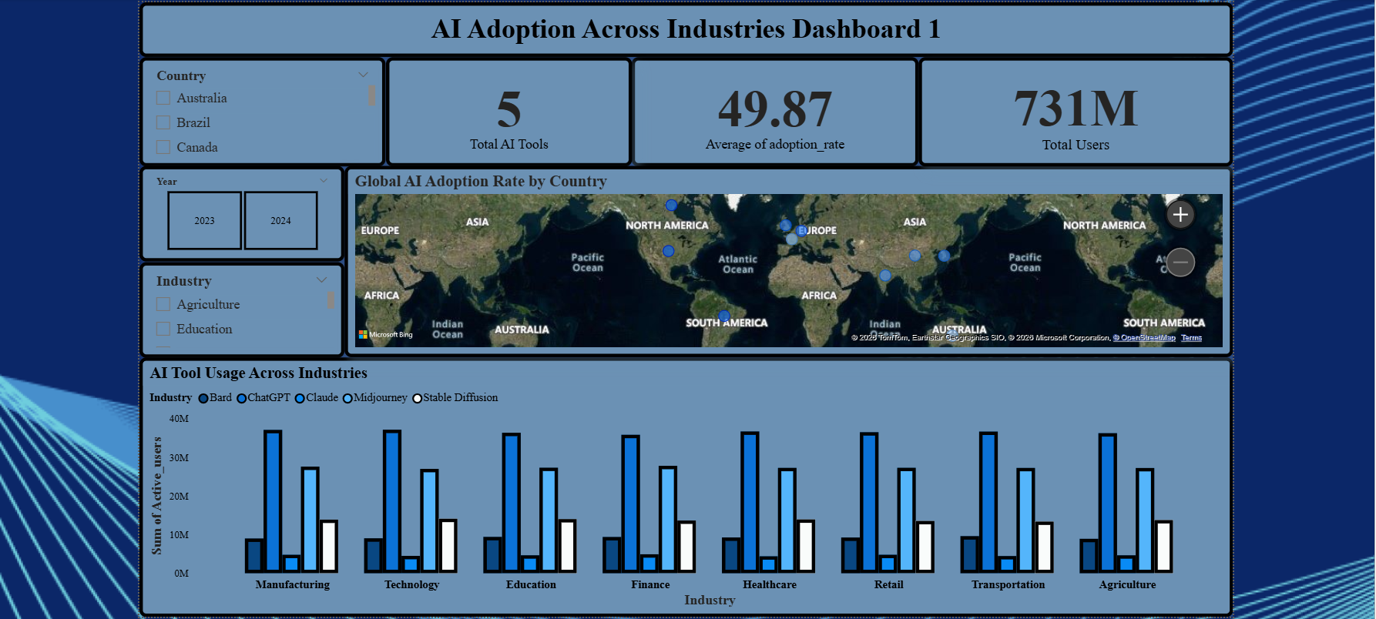

Slide 9
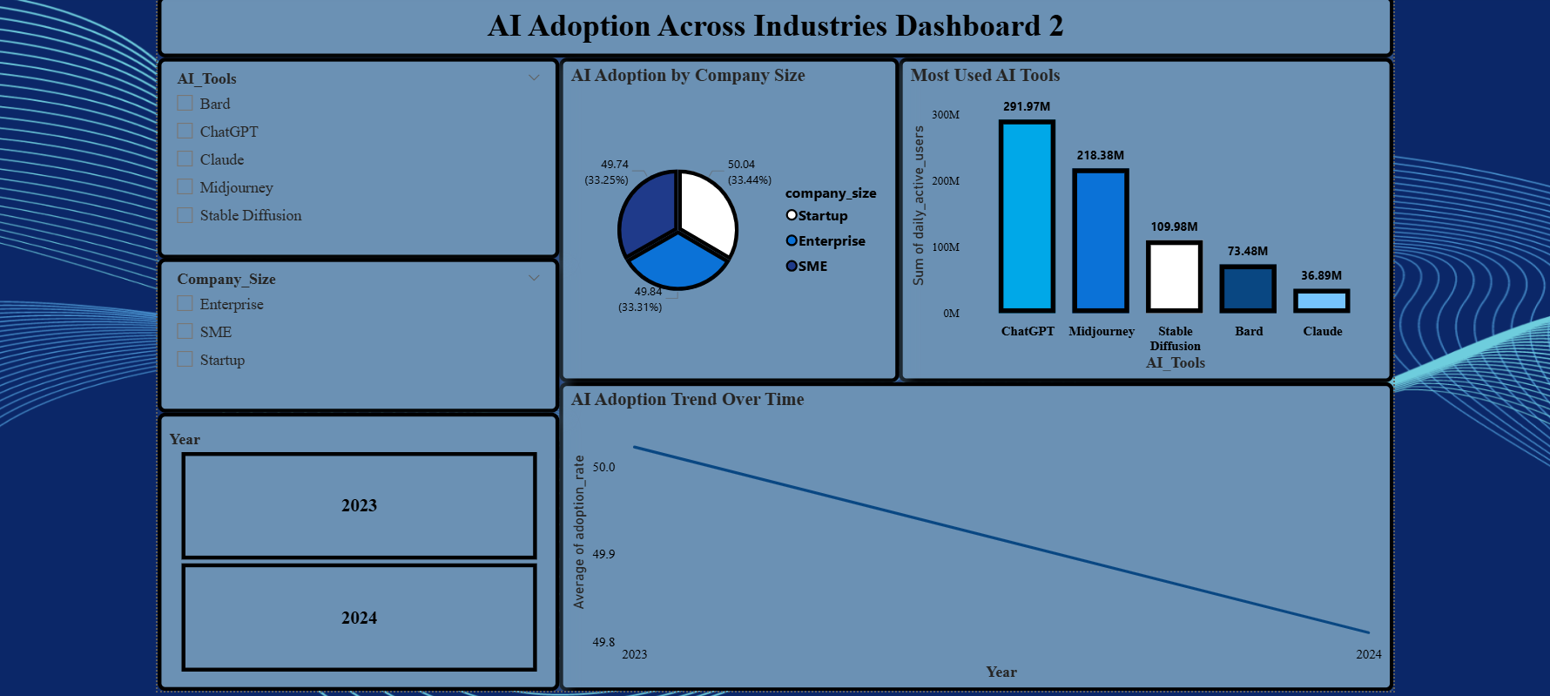

Slide 10
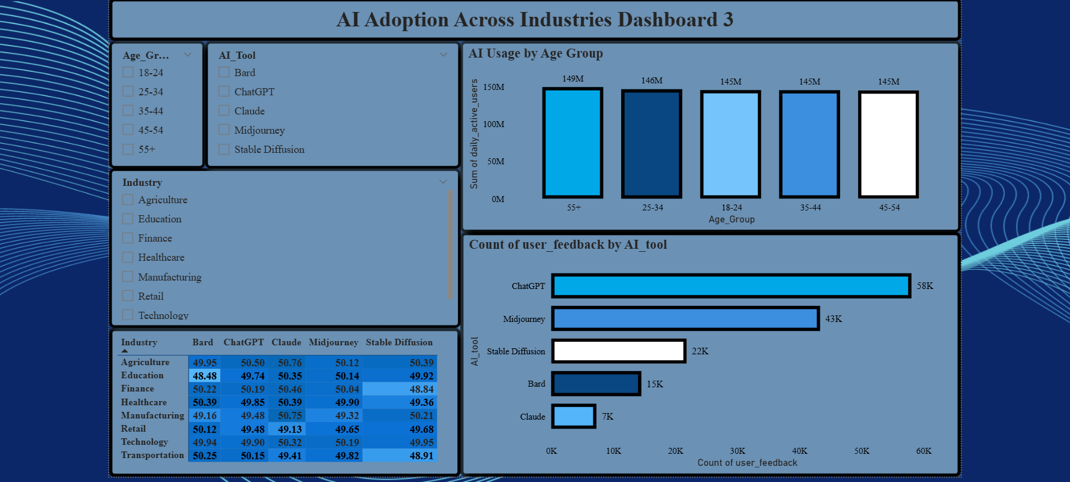

Slide 11
Conclusion:
The project successfully analyzes AI adoption trends across different industries using Power BI. The dashboard provides valuable insights into how organizations are integrating Artificial Intelligence to improve operational efficiency and business performance.
The analysis highlights key industries leading in AI adoption and shows how investment in AI technologies is increasing over time. Such insights can help businesses, researchers, and policymakers make informed decisions regarding future AI strategies.

Slide 12
Future scope:
Future improvements for the system include:
Integrating real-time industry datasets
Applying machine learning models for AI adoption prediction
Expanding the analysis to include more global regions
Incorporating additional business metrics such as productivity improvement and job automation impact
Developing a web-based analytics portal for wider accessibility.

Slide 13
References:
Data Sources: Kaggle AI datasets
Research articles on Artificial Intelligence adoption
Industry technology reports
Tools Used:
Microsoft Power BI
GitHub Link: https://github.com/Shravani2712/AI-Adoption-Across-Industries-Power-BI-Dashboard

Slide 14
Thank You

